Slide 2
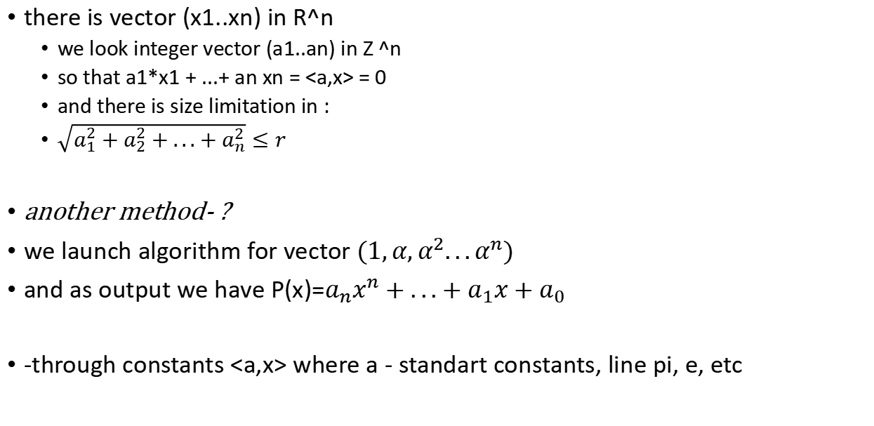
Inverse symbolic calculation
there is vector (x1..xn) in R^n
we look integer vector (a1..an) in Z ^n
so that a1*x1 + ...+ an xn = <a,x> = 0
and there is size limitation in :
$\sqrt{a_{1}^{2}+a_{2}^{2}+...+a_{n}^{2}}≤r$
another method- ?
we launch algorithm for vector $(1,α,α^{2}...α^{n})$
and as output we have P(x)=$a_{n}x^{n}+...+a_{1}x+a_{0}$
-through constants <a,x> where a - standart constants, line pi, e, etc

Slide 3

euler transform :
ln2 =$\sum_{k=1}^{∞}{\frac{1}{2^{k}k}}$
multiply on $2^{k}$ and take fraction part :
{$2^{k}$ln2} = ...
end of paper

